Slide 1
The Maverick’s Choice
Here, value is the reflection of our services.

Slide 2
Contents
Our Services
End-End
Management
Our Commitments
Our
appearance
Mission
1
2
3
4
5
6
7
8
9
Vision
Recruitment flow
Our Team
Learning
Community

Slide 3
Who.. we are !
We are one of the largest global HR services firms. We combine our passion for people with intelligent technology to help organizations and talent convert potential into performance.
Our highly selective clients trust us to source and secure the best contract and permanent candidates to contribute to their success. We’ve placed over 5,60,000 professionals across 25 countries and invest time to understand the exact requirements of our clients with the aim to build long-term recruitment partnerships.

Slide 4

Our Mission
We champion recruitment partnerships with all our job seekers and hiring companies. This allows us to deliver bespoke, effective and creative recruitment solutions so you can focus on innovating in ways that preserve, protect and evolve our population
We provide an uncompromising approach for excellence, professionalism, and tailored care and service for our customers and candidates.

Slide 5
What.. we deliver
We are dynamic and entrepreneurial recruitment firm dedicated to securing top talent for employers of choice. At the heart of our efforts is a collaborative, consultative approach aimed at building strong, successful teams. Our team members have more than 20 years of recruitment experience and are dedicated to ensuring that the client as well as the candidate has a positive recruitment experience. Recruitment Partners guarantees our client’s satisfaction.

Slide 6


One-Time Hiring
Team Hiring
Utilize our network of experienced professionals to fill a single position, fast.
Benefit from the combined knowledge of our function-specific recruiters to build a team for a project, with on simplified hiring process.

Slide 7
Our Core Services
Permanent Hire
Executive Search
Managed Service
Provider
Interim Hire
Recruitment Process
Outsourcing

Slide 8

Interim Hire
Interims are brought into an organization on a temporary basis to help out with specific project needs or to fill a temporary skills shortage. A career as an interim can offer you more flexibility as well as exposure to a wide variety of companies and projects.
Good interim candidates are highly skilled professionals that can come in on short notice and pick up a project right where it was left off.

Slide 9

Permanent Hire
Our consultants undertake headhunting activities on a daily basis to identify skilled, hard-to-find candidates, and this proactive search methodology ensures we continuously develop and engage our network of life sciences professionals.

Slide 10

Executive Service
Executive Service means a position in the Executive Branch that is the chief administrator of a principal unit or comparable position that is not the result of an election or required by the State Constitution, or a deputy or assistant secretary of the principal unit or similar position that has similar stature.

Slide 11

Managed Service
Provider
A managed services provider program is a highly effective way for employers to manage their contingent workforces. An MSP provider can deliver a host of benefits, including: market expertise.
Similar to recruitment process outsourcing programs, MSP programs can be customized, planned, managed and implemented in a manner that truly reflects your organization’s needs, your position in the market and your Employer Value Proposition.

Slide 12

Recruitment Process
Outsourcing
Recruitment Process Outsourcing (RPO) is when a company transfers all or part of its permanent recruitment to an external provider.
An RPO provider can act as an extension of a company's HR or Resourcing function, sitting on site with the client providing a holistic hiring solution.

Slide 13
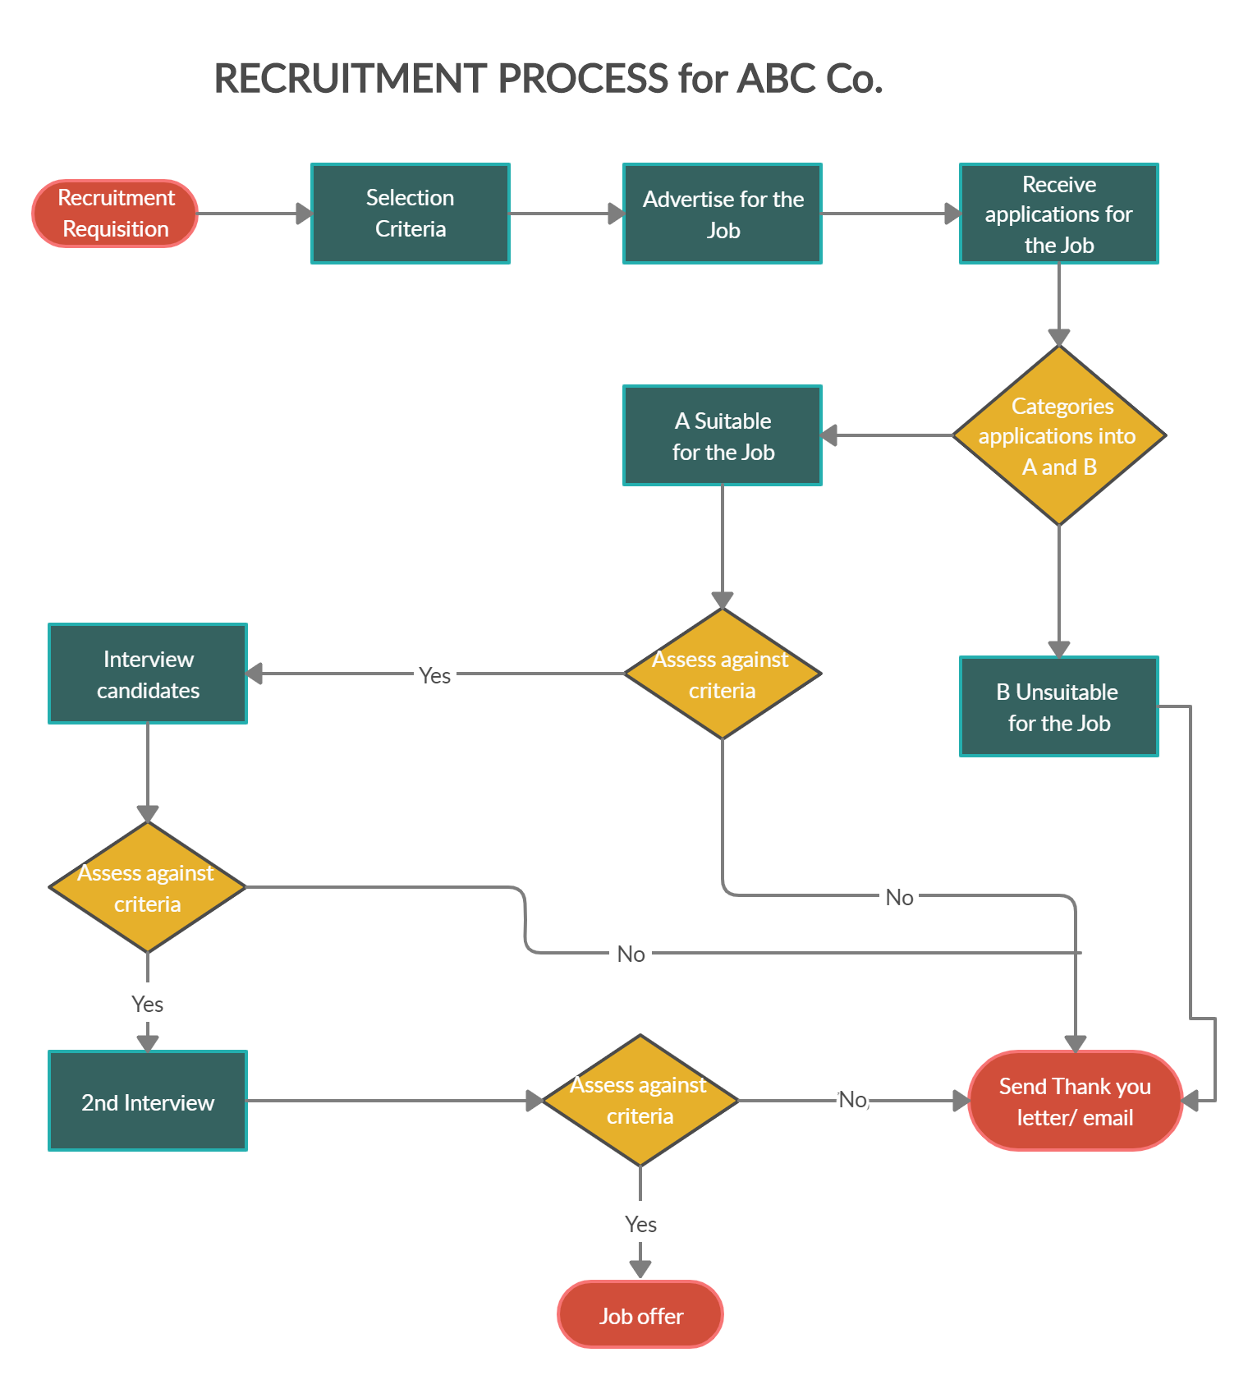
Recruitment
FLOW CHART

Slide 14
Our
End-to-End
Management System

Slide 15
How we deliver….
Define
Discovery
Development
Delivery
Ongoing Recruitment support
Defining the role
Candidate Submission
Interview Process
Project
Specific
Training
Sourcing & Headhunting
Review & Shortlisting
Offer &
Acceptance

Slide 16


Understanding The Requirement
Our first step is to understand your company and team values, working with you to identify your ideal candidate. We then work backwards from your preferred start date to create your bespoke recruitment delivery plan.

Slide 17

Sourcing & Headhunting
Our specialist consultants will search through our database of over 60,000 professionals and proactively headhunt relevant candidates for your role. With access to international search and advanced recruitment technology, we offer a range of sourcing options, including same day search.

Slide 18

Candidate Submission
All submitted candidates go through a rigorous vetting process to ensure we only send you relevant, engaged and available options. We check availability, confirm expectations and pre-interview all submitted candidates before we send them to you.

Slide 19

Reviewing & Shortlisting
Shortlisting is the process of identifying the candidates that meet the criteria laid out in the job listing.
We provide in depth analysis in reviewing and shortlisting from the big picture.

Slide 20

Assessment Process
Once approved by you, we inform and prepare successful candidates on your chosen interview process. We offers a range of optional digital interview solutions and will facilitate feedback at each stage. We value the perception of your brand as if it were our own and handle feedback for all candidates we submit to your business.

Slide 21

Offer and Acceptance
We develop strong relationships with our candidates and ensure we understand their motivations and expectations; this knowledge is invaluable in supporting you to secure your chosen candidate. We can also offer salary benchmarking and industry trend reports upon request

Slide 22

Ongoing Recruitment Support
Our support doesn’t stop once the offer is accepted. Our consultants provide first day preparations and relocation advice if required. We will keep in touch to see how your new starter is settling in and ensure you are both happy and excited to be working together.

Slide 23


Project Specific Training
Project-Specific Training is designed for participants working on projects with specific goals and problems. Participants will learn how our project specific training can be used to analyze and solve various technical areas. Participants may already have domain training , Work experience and wish to engage in a refresher session, or develop advanced skills in particular domain.

Slide 24
OUR NICKNAMES
Scalable
Flexible
Client friendly
We can handle a growing amount of work by adding resources to the system.
Our business is flexible when the quality of work takes priority over when and where employees deadline.
Our practices involves a good office environment, accessibility, sensible scheduling, helpful staff, and privacy and confidentiality.

Slide 25
Scalability at it’s best ...
We scale our services based on requirement of the recruiter. We scale all the above mentioned management flows.
We also provide overall recruitment support. Our services provide reliability to the clients and adapt to their needs.

Slide 26

Two-Way
Application Tracking
An ATS (Applicant Tracking System) helps you manage your end-to-end recruitment process from sourcing to hiring and helps automate your organization's recruiting and staffing operations.
The application tool provided by us bridge the gap between the candidate and the recruiter. The application is cogently dynamic, that it updates the requirements to meet the standards.

Slide 27
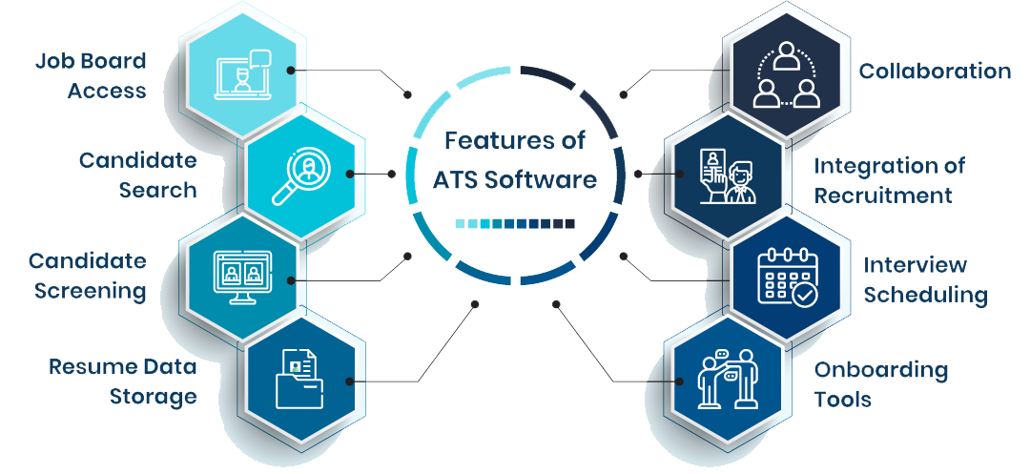
Application Tracking

Slide 28
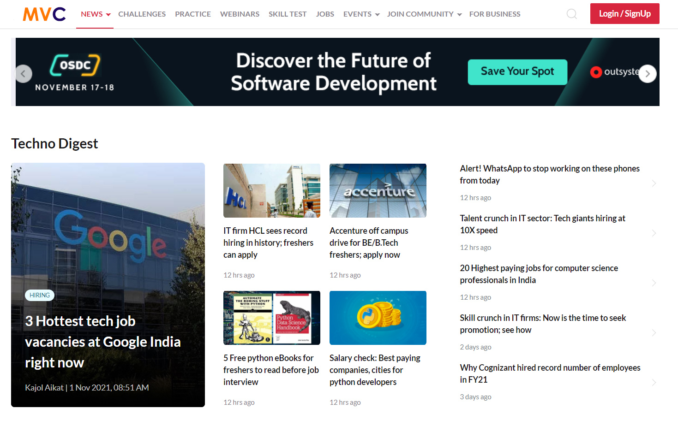
Learning Community
We are India's largest tech community for programmers to read the latest tech news, learn, upskill & compete with fellow techies in hackathons.
MVC is a young and enthusiastic technology company, offering cutting-edge solutions to its clients using innovative technologies.

Slide 29
Community Application
Realtime updates
Learn &
Practice
Evaluate skills
Gain
Experience
For
Companies
Compete & get hired
Join live webinars
Apply for any
Position
Join
discussions

Slide 30
40+ years
50,000+ clients
333,000
Oldest in time
Global resilient client assistance.
professionals hired and still counting

Slide 31

“98% of employers are satisfied with quality of candidate put forward by MVC. “

Slide 32

Q & A

Slide 33
Thank You
By Team B
P. Dakshayani
G. Prem Chandu
M. Amulya
U. Santhosh

